Slide 1

Problem Statement
Identifying the need and feasibility (revenue) for new stations between 2 stations for providing parking spaces at heavy traffic stations. This is to ensure that divvy does not lose customers, based on the parking docks unavailability.
Description: Heavy stations are identified as stations from where most trips start and most trips end and not whose dock capacity is initially larger because we need to identify stations which are the busiest.

Slide 2
Data Cleaning

Slide 3
Data Cleaning
Transformed data present in quarterly form to one single data
Identifying missing values of each variable and removing those particular rows
Merging Dock capacity dataset with the original data frame
Splitting Date and Time in two different columns using str_split
Set Names of all columns which were not aligned after merging
Converting the trip duration variable from string to numeric and changed it in minutes
Added new variable of Dock_diff in order to visualize the difference between arrivals and departures at each station

Slide 4
Exploratory Data Analysis - Graphs

Slide 5

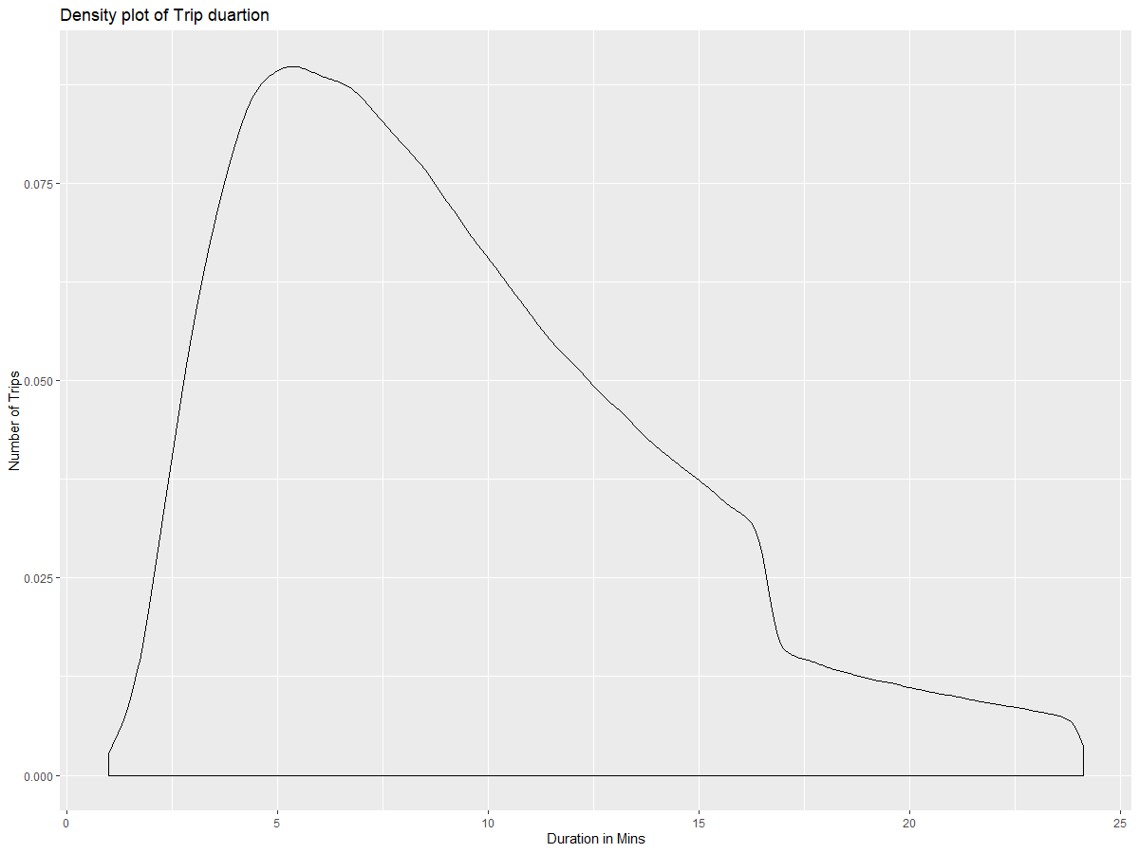
EDA – Part 3
Trip Duration density plot shows that most of the trips ranges from 5 minutes to 10 minutes (all outliers were removed in cleaning)

Slide 6
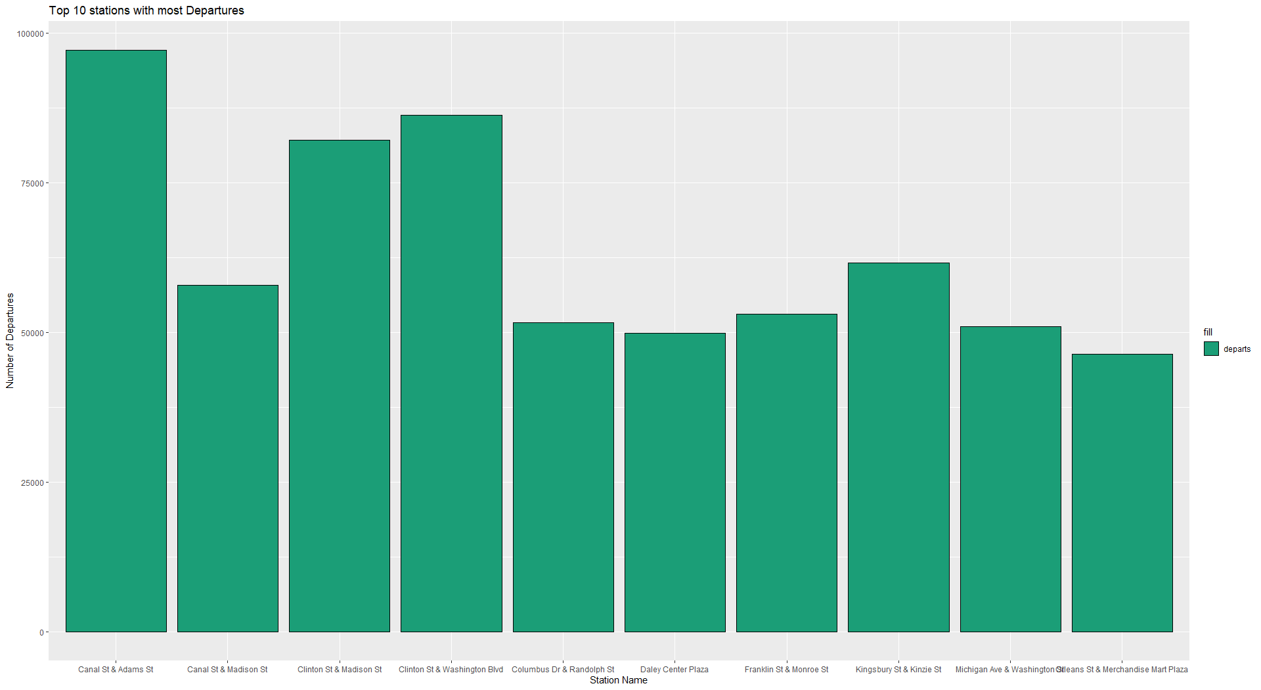
EDA – Part 4
Analyzing the Top 10 busiest stations with the help of bar charts, busy stations are those who have highest number of departures and arrivals in the cumulative dataset. It can be observed that most of these stations are in Central Chicago so ultimately new dock stations if needed to be added should be placed here only.

Slide 7
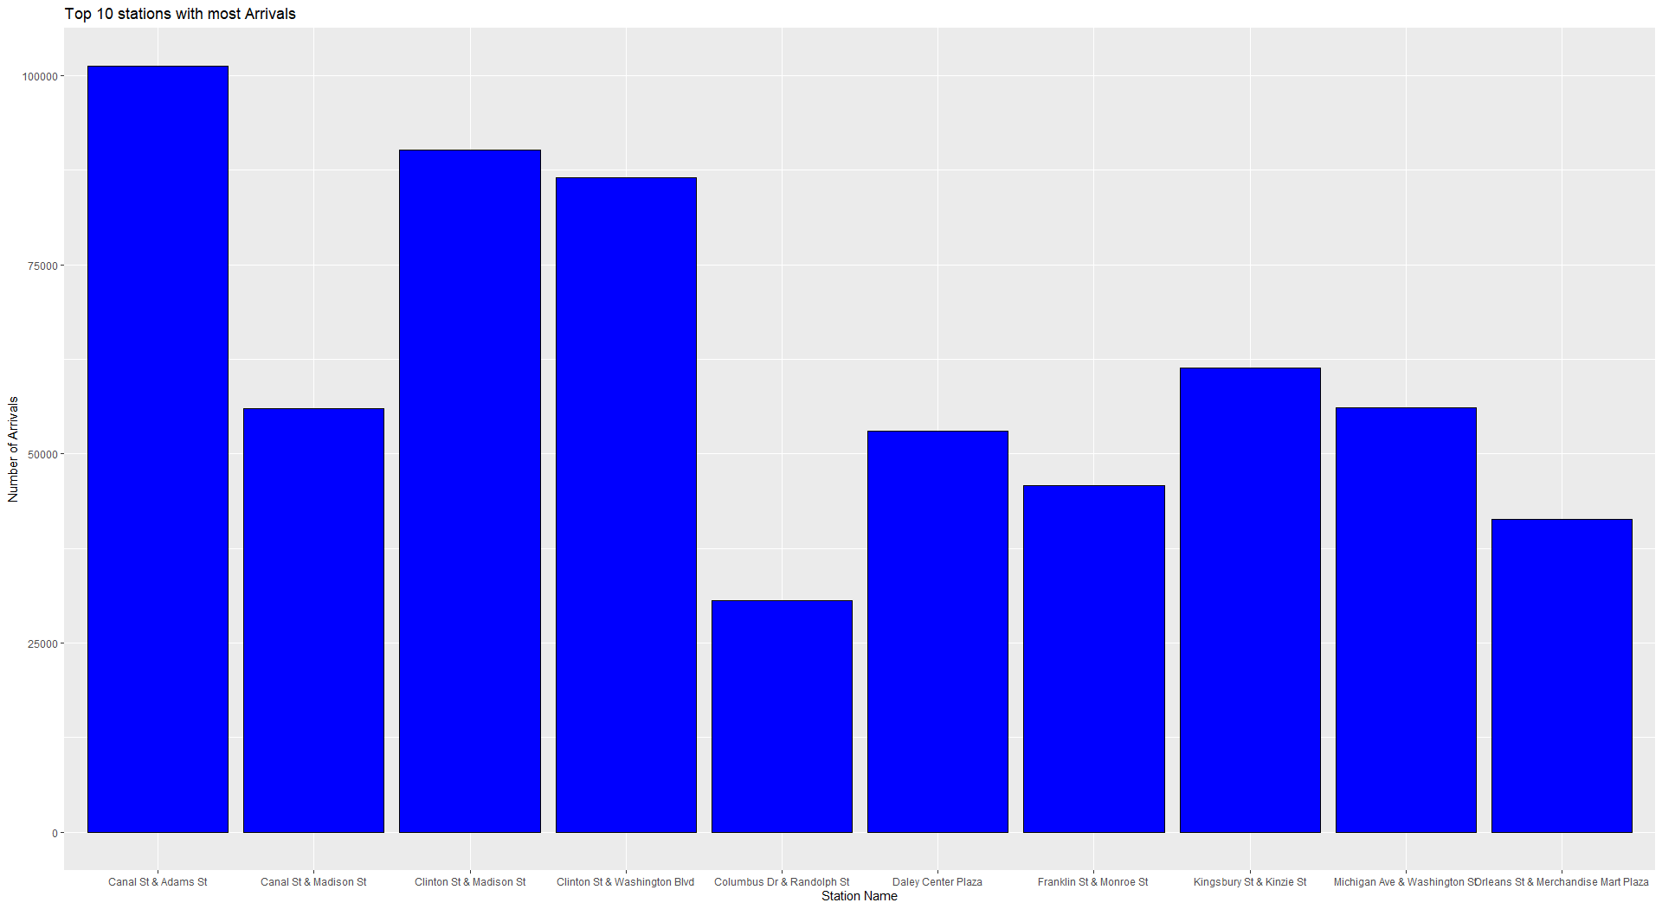
EDA – Part 4
Top 10 Stations with most Arrivals

Slide 8
Machine Learning Model

Slide 9
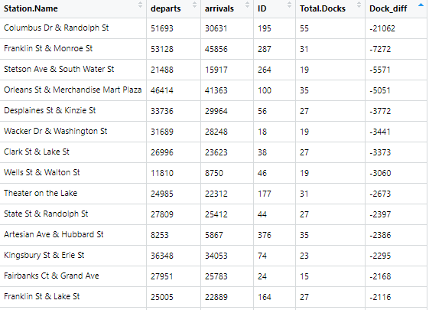
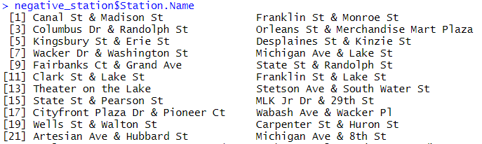
Multi regression and Correlation
Applying Multi regression model to find out the relationship between several variables to determine our target variable and predictors which in this case was also visually analyzed by correlation plot.
Departure and arrival for all 601 stations was calculated and then the difference between arrival and departure was calculated in order to predict the excess or deficit in docks.
Obtained target and predictors were used to compare with existing docks and with the Dock difference and were used to identify where new dock stations can be added.
Conclusion: Assuming $400 for each dock and median docks in each station is 23 and for 22 stations we require about 200k $ for all these developments which is well in the budget of Divvy.
There are 22 dock stations which require extra dock stations in between them and if implemented can help customers in easy availability of Divvy bicycles.

Slide 10
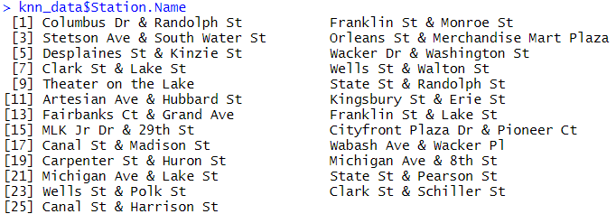
KNN classification
Using KNN classification to validate the results obtained from Multi regression.
Using k=2 we could categorize Dock_diff in the manner of ‘Yes’ or ‘No’ depending on if they needed a new dock station or not.
This was calculated with the help of predictor variables and target variable which were outcome of correlation plot.
Conclusion: There are 25 dock stations which require an additional dock station nearby to ensure no loss of customer.
Total estimated cost of building these 25 dock stations is around 220k $ if dock stations are setup as per this prediction model.

Slide 11
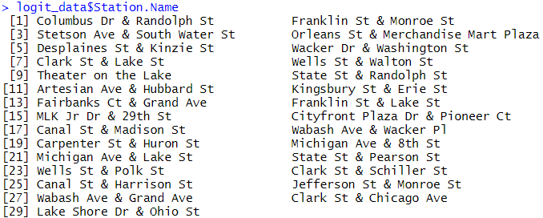
Logistic Regression
Applying logistic regression to predict number of dock stations required based on predictor variables duration.mins, to_station_id, Longitude, Latitude, Total.docks identified using correlation matrix.
Obtained probabilities were rounded off only when greater than 80% and costing was calculated assuming each dock setup requires $400.
Conclusion: There are 29 dock stations which require an additional dock station nearby to ensure no loss of customer.
Total estimated cost of building these 29 dock stations is around 260k $ if dock stations are setup as per this prediction model.

Slide 12
Conclusion
Out of three ML algorithms applied it can be observed that KNN Classification gives the best result because if we remove outliers the remaining dock stations that require new dock stations between them are 24 which is closes to the prediction of KNN classifier. Divvy can either add in more docks at particular stations or open new dock stations eventhough opening new stations will attract new customers. So it is better to add in new stations between the predicted station names.

